Slide 1
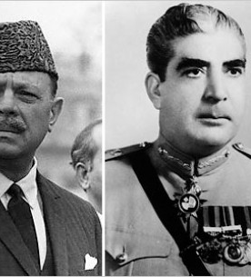
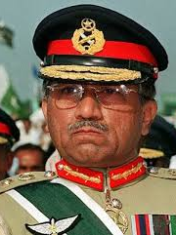
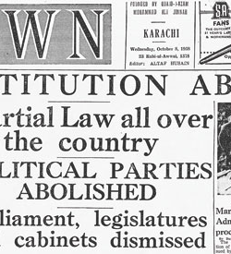
MILITARY AND POLITICS IN PAKSITAN

Slide 2
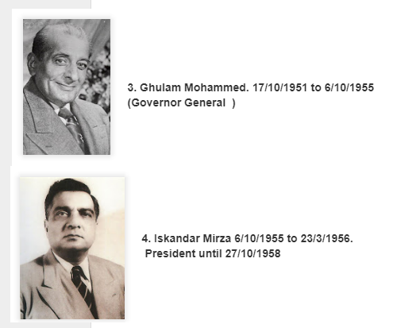
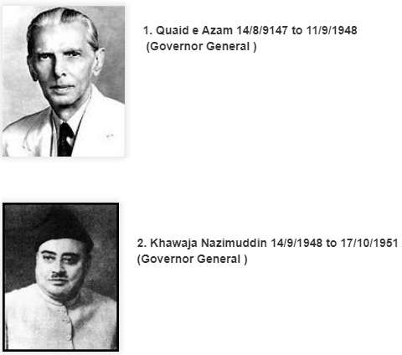
Governor Generals

Slide 3
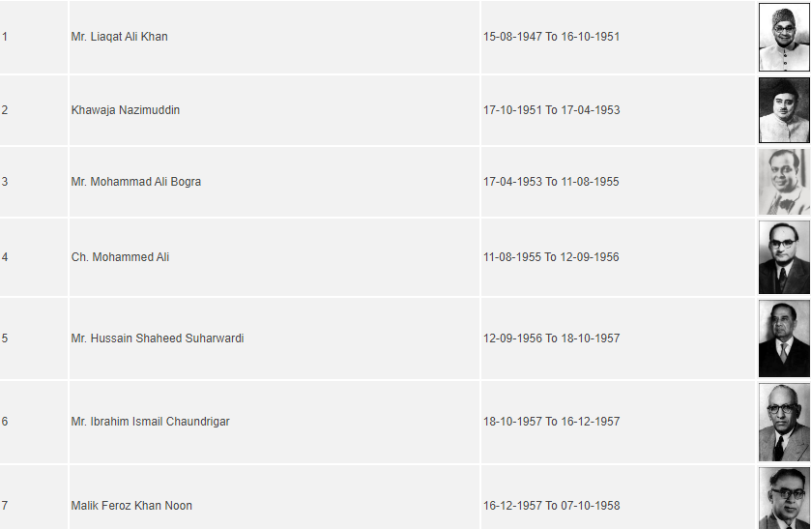
Prime Ministers of Pakistan 1947-1958

Slide 4
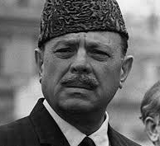
General Ayub Khan 27 October 1958 – 25 March 1969

Slide 5
On October 7, 1958, President Iskander Mirza abrogated the Constitution and declared Martial Law in the country. This was the first of many military regimes to Pakistan’s history. With this step, the Constitution of 1956 was abrogated, ministers were dismissed, Central and Provincial Assemblies were dissolved and all political activities were banned.
General Muhammad Ayub Khan, the then Commander-in-Chief of the armed forces, became the Chief Martial Law Administrator. The parliamentary system in Pakistan came to end. Within three weeks of assuming charge on October 27, 1958, Iskander Mirza was ousted by General Ayub Khan, who then declared himself President.

Slide 6
Policies
All government servants was conducted and service records were closely scrutinized.
Elective Bodies Disqualification Order
Improvement in Agriculture Sector
land reforms in West Pakistan.
Basic Democracies
Constitution Commission

Slide 7
Negative Impact
Increased inequality in the distribution of wealth.
Politics after Indo-Pakistani War of 1965
Government corruption and nepotism.
1964 Presidential elections against Fatima Jinnah is a subject of criticism by many writers

Slide 8
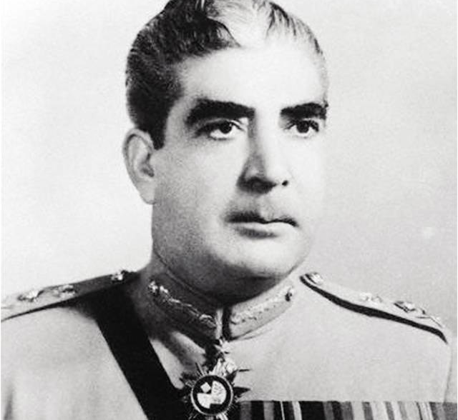
General Yahya Khan 25 March 1969 – 20 December 1971

Slide 9
General Yahya Khan
Yahya Khan was the second Chief Martial Law Administrator of Pakistan. Ayub Khan, his predecessor, at the time of his fall in 1969 gave him that status. After six days of assuming power as the CMLA, Yahya Khan became the President of Pakistan on 31 March 1969 and kept that position till 20 December 1971.

Slide 10
Events
a: Legal Framework Order 1970
b: Dissolution of One-Unit
c: Holding of Pakistan’s first free elections on adult franchise
d: Success of Pakistan Peoples Party in West Pakistan and of Awami League in East Pakistan that confirmed the drastic political differences between the two wings of the country.
e: The war of 1971 and the division of Pakistan.

Slide 11
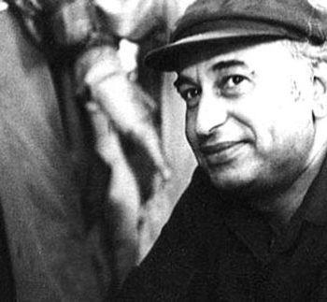
Zulfikar Ali Bhutto January 5, 1928-Apr 4, 1977

Slide 12
Zulfikar Ali Bhutto January 5, 1928
Served as the President of Pakistan from 1971 to 1973
Prime Minister of Pakistan from 1973 to 1977.
Founder of the Pakistan People’s Party (PPP
Bhutto is often addressed as the Quaid-e-Awam.

Slide 13
Policies
Bhutto adopted a new constitution for Pakistan.
Prime minister, Bhutto nationalized many industries. founder of Pakistan’s nuclear weapons programme
General Elections were held on March 7, 1977. PPP emerged as the victorious Party.
PNA accused government of rigging in the elections. Negotiations with PNA resumed.
On July 5, 1977 COAS General Zia-ul-Haq imposed Martial Law.

Slide 14
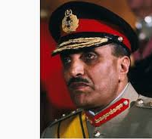
General Muhammad Zia-ul-Haq (September 16, 1978 – August 17, 1988)

Slide 15
Strategies
Establishment of the Majlis-i-Shoora.
General Zia-ul-Haq introduced
He introduced the Zakat, Ushr, Islamic Hadood and Penal Code in the country.
A numbers of other Islamization programs were carried out including the teaching of Islamic Studies and Arabic, which were made compulsory.
A Shariah Council consisting of ulema was established to look into the constitutional and legal matters of the State
Zia's Government introduced the Hadood Ordinance for the first time in Pakistan.
Feed more than three million Afghan refugees.
The 1973 Constitution of Pakistan envisaged a Parliamentary System of government.

Slide 16
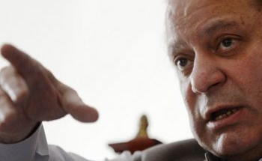
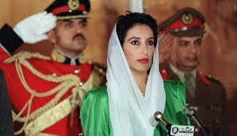
DEMOCRACY 1988-1999

Slide 17
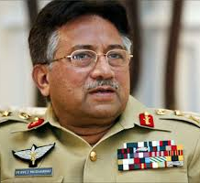
General Pervaiz Musharaf (20 June 2001 – 18 August 2008)

Slide 18
On October 12, 1999, the Pakistan Army once again ousted the Civilian Government. Chief of Army Staff General Pervez Musharraf assumed the title of Chief Executive. Although the use of the term “Martial Law” was avoided, Pakistan once again came under military rule. It was claimed that the Army was forced to take this step to save the country from “turmoil and uncertainty”.
General Pervaiz Musharaf

Slide 19
Strategies
General Musharraf did his best to highlight the core issue of Kashmir at every international forum.
In order to establish democracy at grassroots level, the regime of General Pervez Musharaf, introduced the Local Government System.
The District Government
Tehsil Administration
Union Administration
The Legal Framework Order 2002 that has been accepted as part of the Constitution with minor modifications.

Slide 20
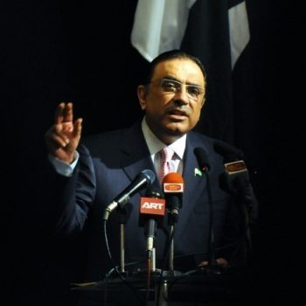

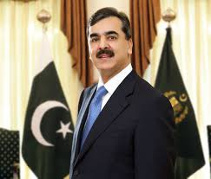
Democracy 2008

Slide 21
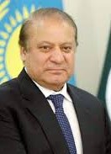
ELECTIONS 2013
It was a dream start for Nawaz Sharif in 2013-election, as his party, Pakistan Muslim League (PML-N), swept polls in Punjab, enabling him to become the prime minister for the third time.

Slide 22
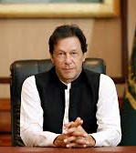
ELECTIONS 2018
Imran Ahmed Khan Niazi is the 22nd and current Prime Minister of Pakistan and the chairman of the Pakistan Tehreek-e-Insaf.

Slide 23
Conclusion!! Q & A

